Slide 1
Electricity Billing System

Slide 2
Introduction
Electricity Billing System is a Desktop-based application.
i. This project aims at serving the department of electricity by computerizing the billing system.
ii. It mainly focuses on the calculation of units consumed during the specified time and the money to be charged by the electricity offices.
iii. This computerized system will make the overall billing system easy, accessible, comfortable, and effective for consumers. To design the billing system more service oriented and simple, the following features have been implemented in the project. The application has high speed of performance with accuracy and efficiency

Slide 3
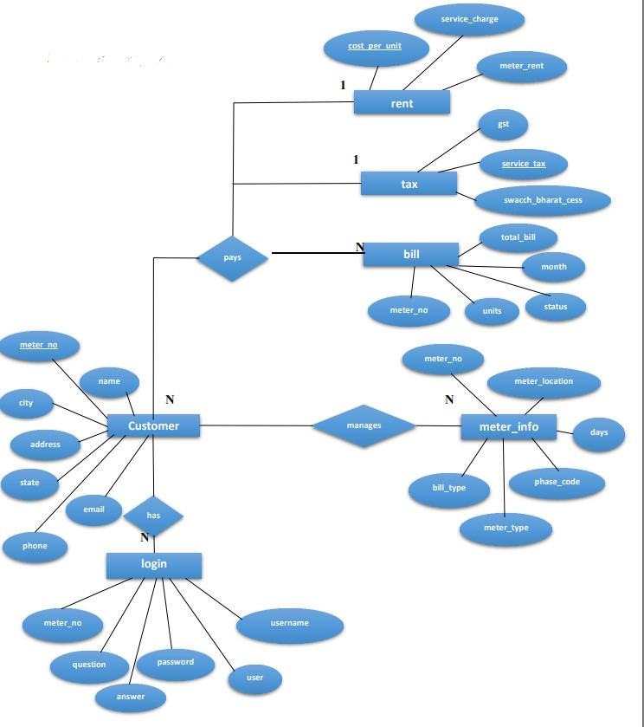
ER Diagram

Slide 4
Explanation of pseudo code
Start system
Enter login name and password
On clicking the login button
Connect to database
Query database to know whether user credentials are correct
If not, deny access and return login page with an error message
If correct, check if credentials for administrator
If yes, allow login
Set admin session, re-direct administrator to admin login page
If no, allow login set user session
Re-direct user to user home page

Slide 5
Database Snapsort
The given below table is a snapshot of backend view of the localhost and the structures of the tables present in Electricity Billing System. The tables present are login, customer, tax, bill, meter_info.
The login is used to store the details of login’s admin and customer with meter_no.
The customer is used to store details of customer.
The tax is used to store tax values.
The rent is used to store rent values.
The bill is used to store details of bill of meter.
The meter_info is used to store information of meter placed.

Slide 6
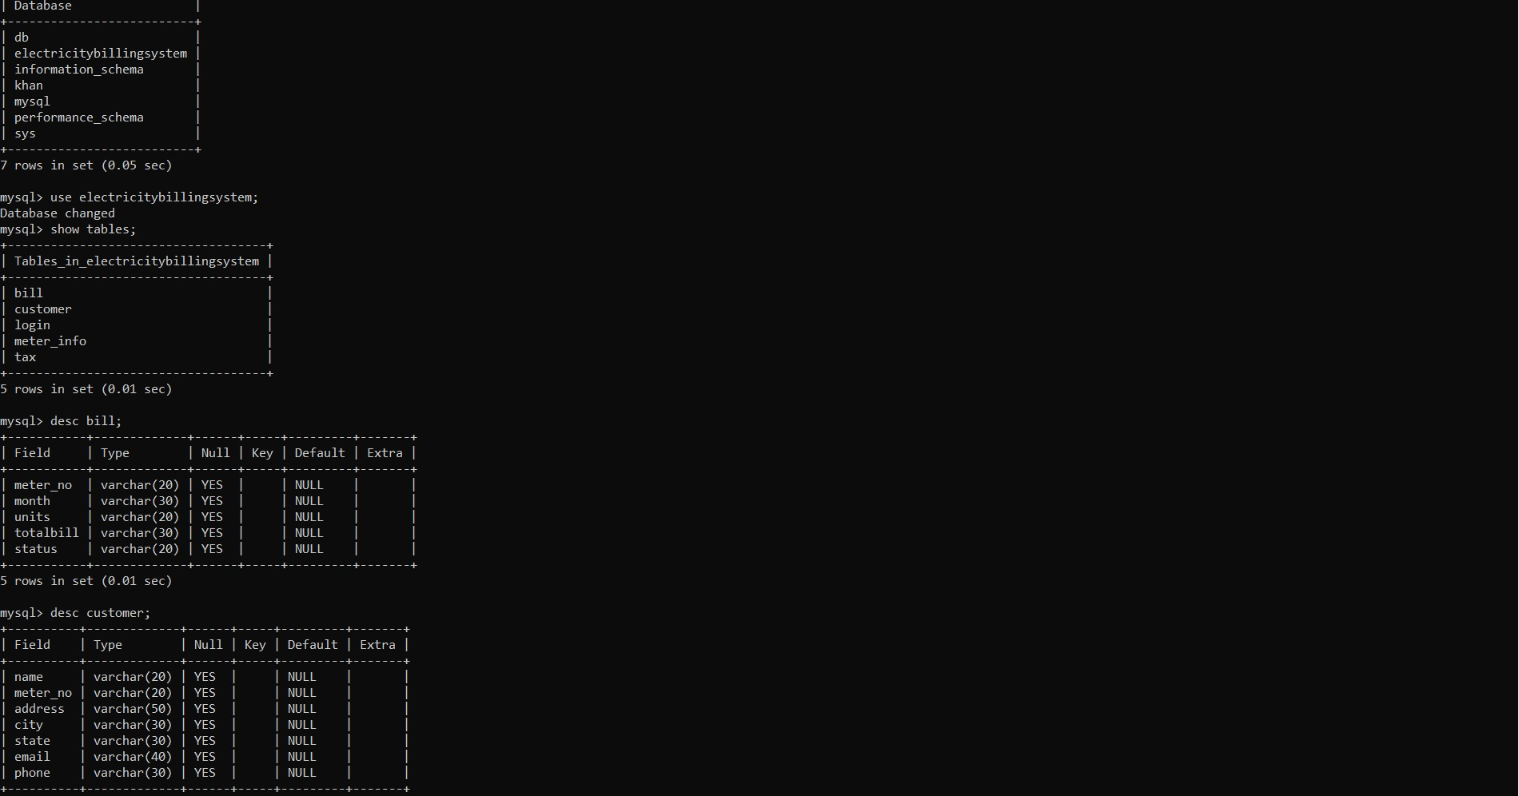

Slide 7
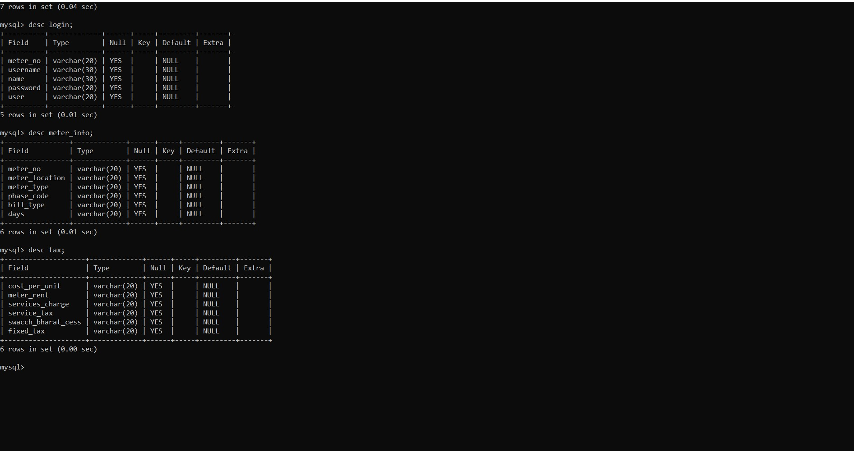

Slide 8
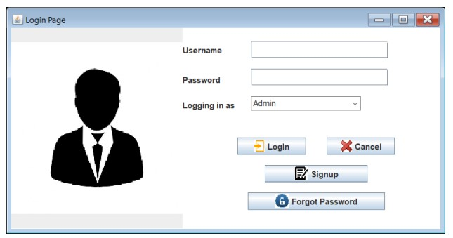

Slide 9
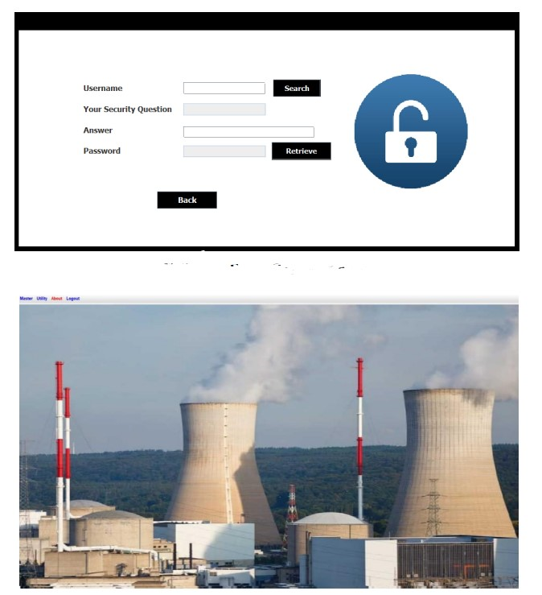

Slide 10
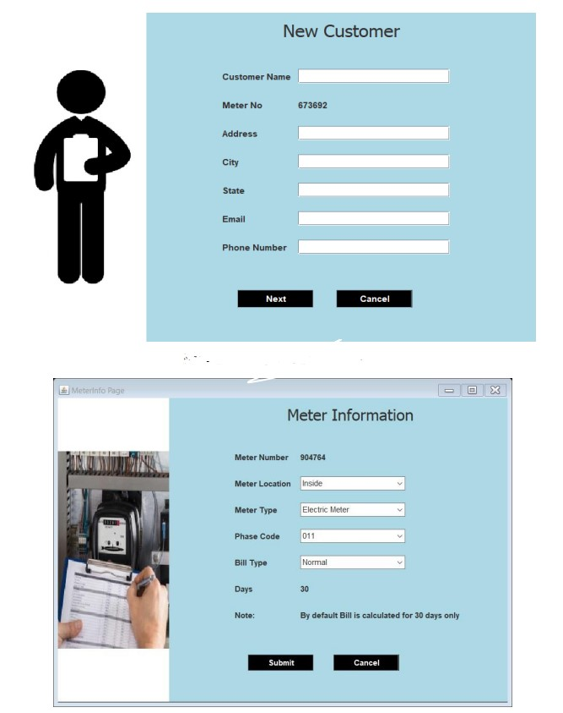

Slide 11
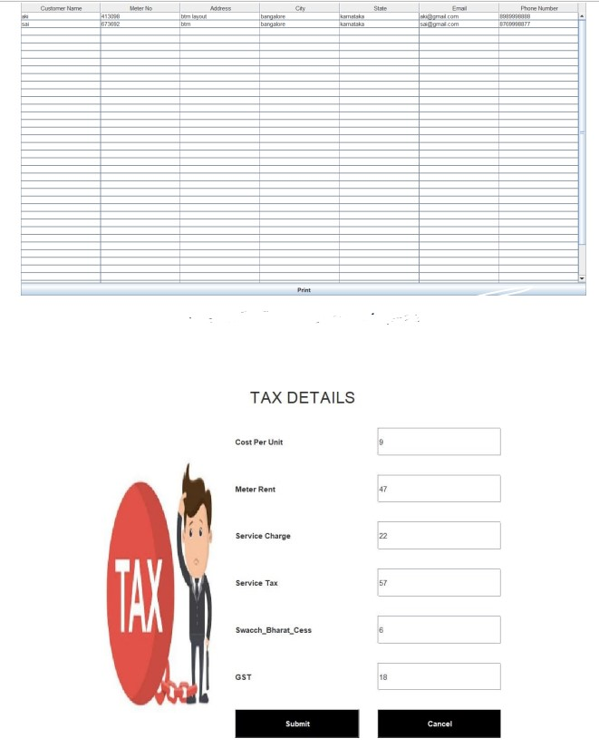

Slide 12
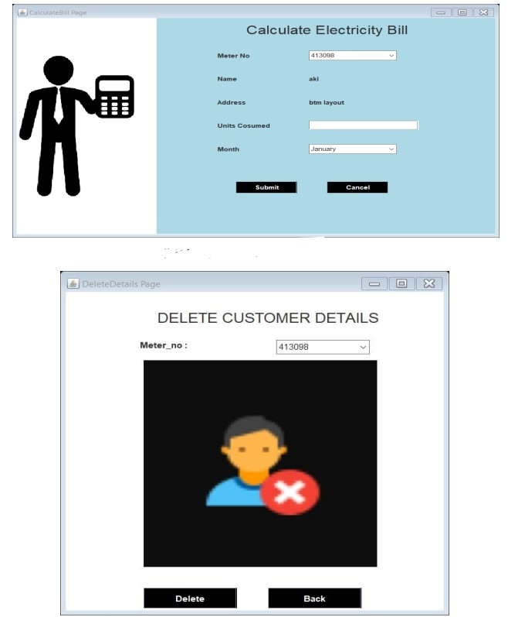

Slide 13
Conclusion
It is a application which helps the user to work with the billing cycles, paying bills, managing different DETAILS under which are working etc.

Slide 14
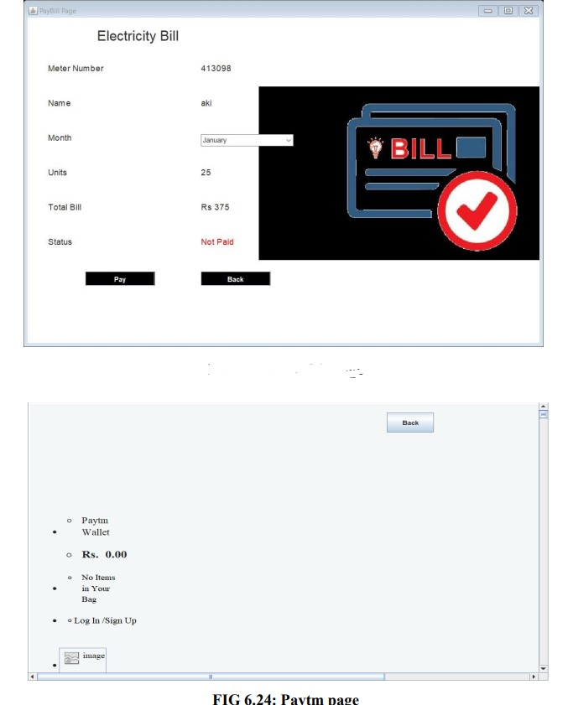

Slide 15
